Slide 1
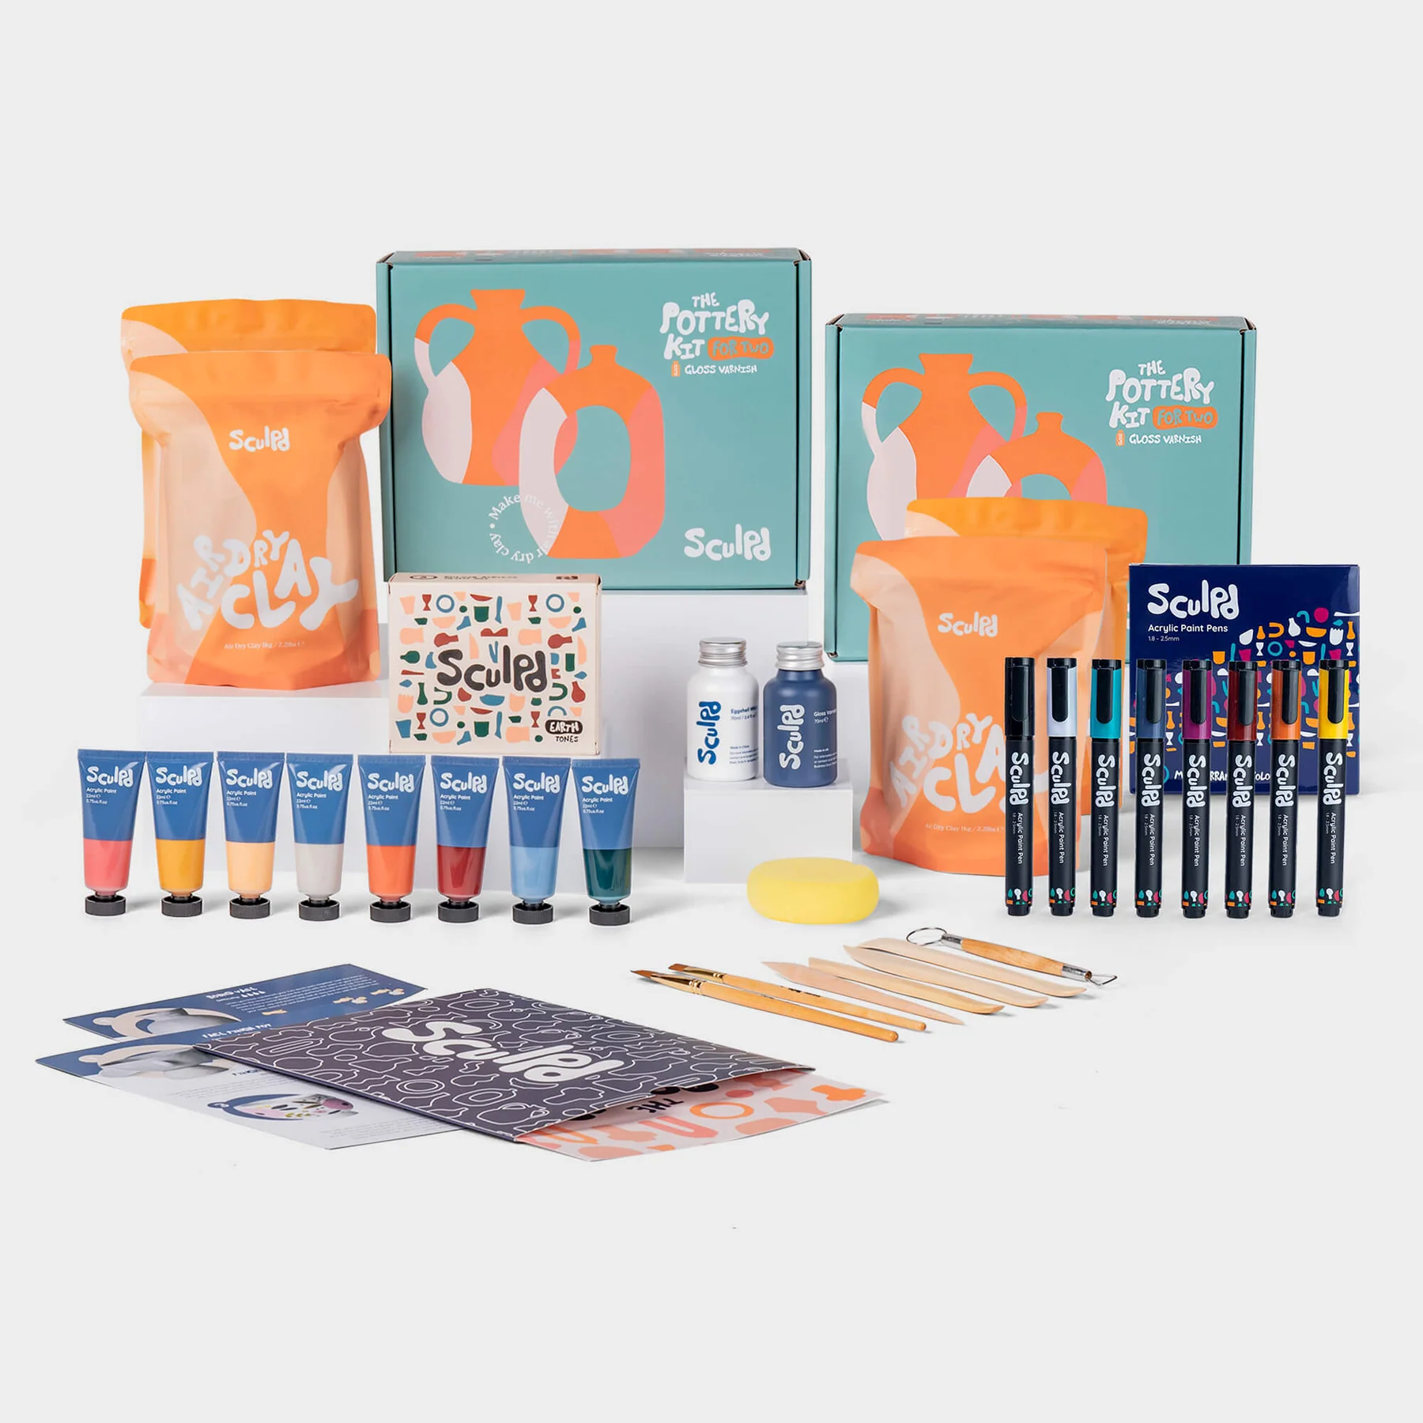
Pottery Making and Ceramic Painting
Shawna tuli (Shawna.tuli@avanade.com)
Northern California wellness

Slide 2
Bundle for 4-6 2 x Sculpd Pottery Kits 8.8lbs of clay! Enough for 4 people to make a large creation or two smaller creations each.
OR for 6 people to make a medium sized creation each. Each Kit Contains: - 4.4lbs Premium Sculpd Air-Dry Clay - 20 Piece Step-By-Step Beginners Pottery Guide - Pottery Carving, Shaping and Cutting Tools & Tool Bag - White Acrylic Eggshell Paint - Waterproof Gloss & Matte Varnish - 2 Ultra Fine Bristle Paintbrushes - Potter's Sponge for Smoothing 1 x Paint Set of your choice Contains 8 x 22ml Sculpd Acrylic Paint Choose one of our four curated color palettes: - Earth Tones - Pastel Tones - Floral Tones - Classic Tones
1 x Favorites Paint Pens (8 Colors)
Our best selling acrylic paint pen set - use on top of our paints to create detailed illustrations on your pieces.
Bundle for 6-8
3 x Sculpd Pottery Kits
Over 13lb of clay! Enough for 6 people to make a large creation or two smaller creations each.
OR for 8 people to make a medium sized creation each.
2 x Paint Sets of your choice
16 paint colours to choose from! Each set contains 8 x 22ml Sculpd Acrylic Paint
1 x Favorites Paint Pens (8 Colors)
More than enough for everyone to pass around!
__________
If stored unopened in the sealed bag the clay will last 3 - 6 months.

